Slide 1
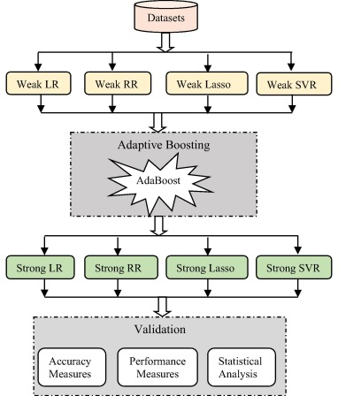
AdaBoostRegressor:
AdaBoostRegressor is an ensemble method for regression that combines multiple "weak" regressors (e.g., decision trees) to create a strong predictor.
It works by iteratively training regressors on the data, assigning higher weights to instances that were mispredicted by previous regressors.
The final prediction is a weighted sum of the predictions from all regressors.

Slide 2
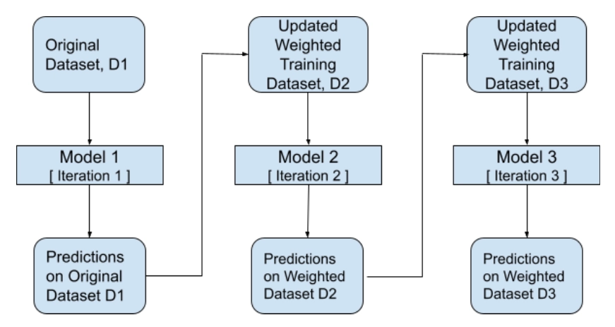
Function uses in python notebook:
from sklearn.ensemble import AdaBoostRegressor
Regressor = AdaBoostRegressor(random_state=0, n_estimators=100)
Regressor.fit(X, y)

Slide 3
XG Boosting:
Extreme Gradient Boosting
powerful and efficient machine learning algorithm often used for regression tasks
It is an optimized implementation of gradient boosting, known for its speed and performance
Gradient boosting can be used for regression and classification problems
Function uses in python notebook:
from sklearn.ensemble import GradientBoostingRegressor
Reggresion = GradientBoostingRegressor(random_state=0)
Reggresion.fit(X_train, y_train)

Slide 4
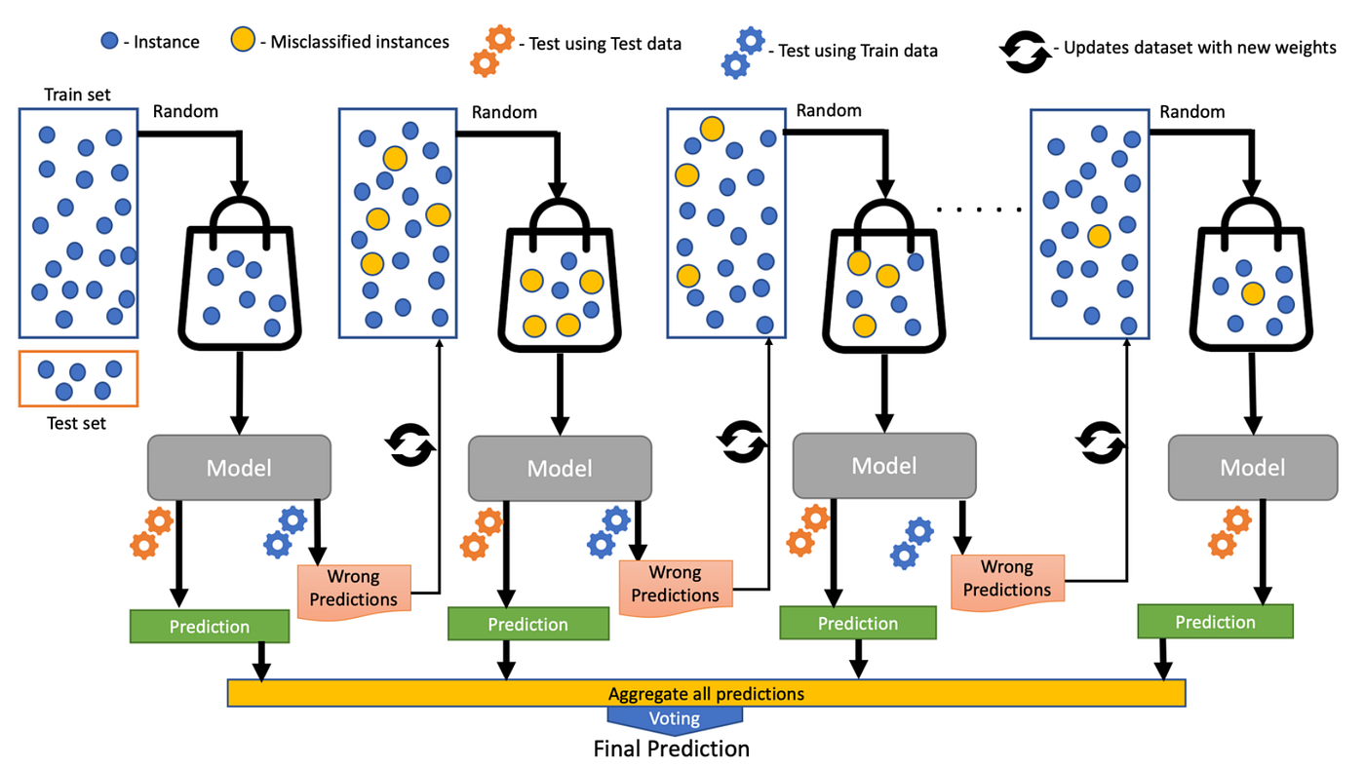

Slide 5
LG Boosting:
Light Gradient Boosting
Less Memory Usage
Reduction in Communication Cost for parallel learning
Reduction in Cost for calculating gain for each split in the decision tree.
LGBM is a quick, distributed, and high-performance gradient lifting framework which is based upon a popular machine learning algorithm – Decision Tree.
It can be used in classification, regression, and many more machine learning tasks.
This algorithm grows leaf wise and chooses the maximum delta value to grow.

Slide 6
